Slide 1
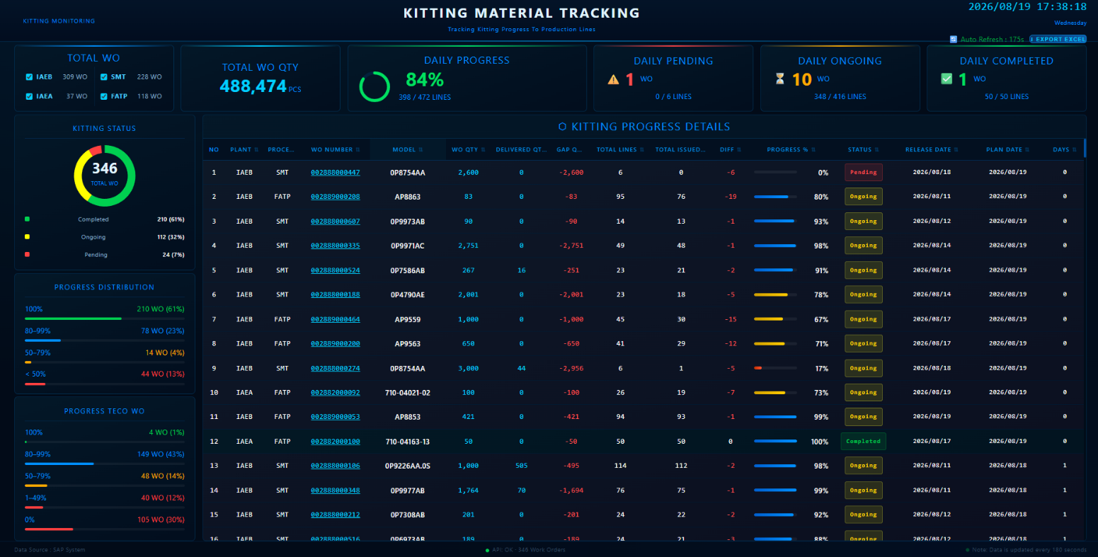



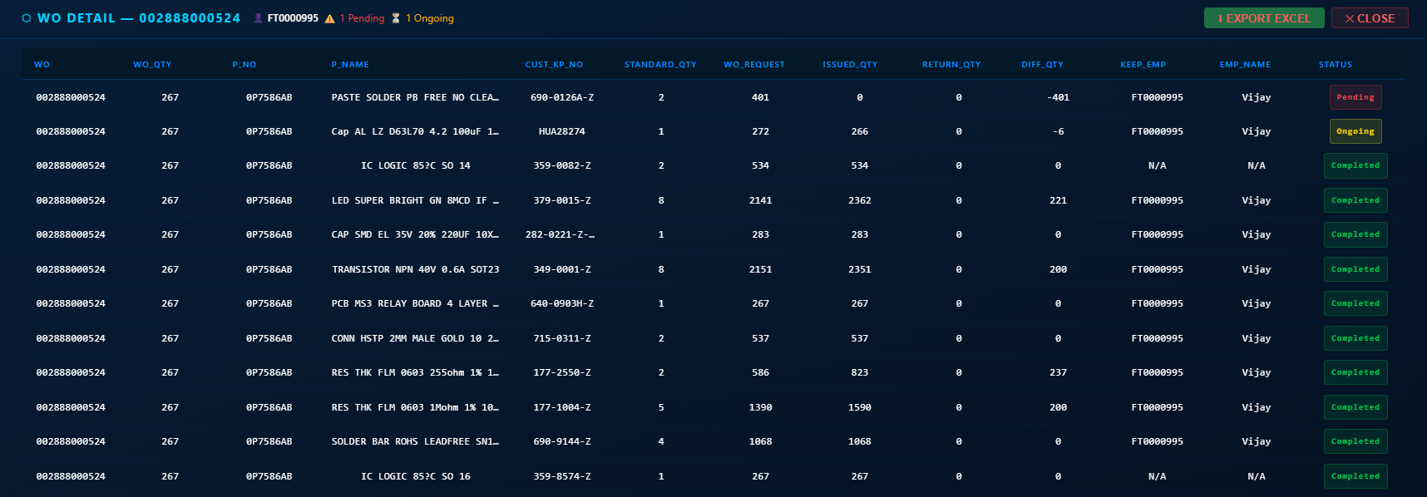


KITTING MATERIAL TRACKING
Real-time SAP-connected dashboard for kitting progress monitoring
Project member:
WH：Tung Chieh, Ben
IT Development：Chown
HOW TO USE THE DASHBOARD
LIVE DASHBOARD — IN PRODUCTION
2026/08/19
01
Set the scope
Select plant (IAEB / IAEA) process:(SMT / FATP) to focus daily review.
02
Prioritize execution
Watch Pending, Ongoing and Completed WOs update live against the PC’s plan.
03
Drill down fast
Filter by kitting status
Click any WO number to see full PN-level quantities, gaps and status.
04
Complete posting & close the loop
Monitor posting completion after kitting checkout, follow up on posting gaps and support WO Closure and TECO readiness
OUTCOME
Real-time visibility of kitting and posting progress for WH, PC & Production — replacing manual, delayed tracking.
WO Drill-down on Click
BEFORE
AFTER
Manual phone / Excel updates, no real-time visibility
Live SAP-connected dashboard.

Slide 2
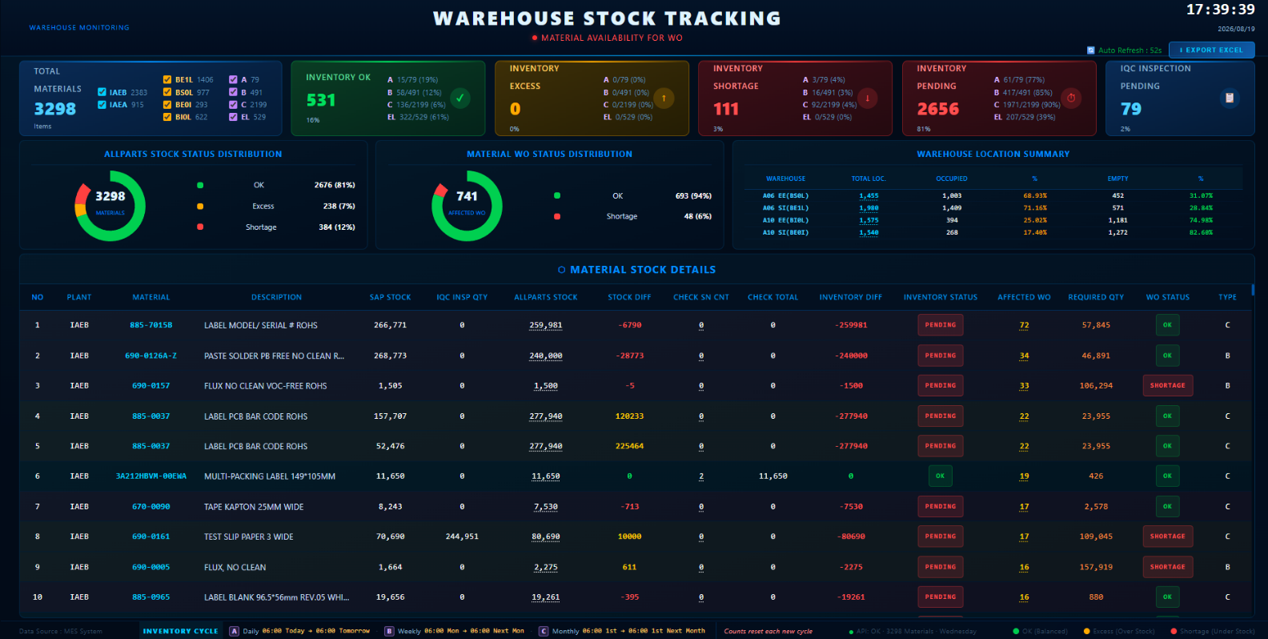
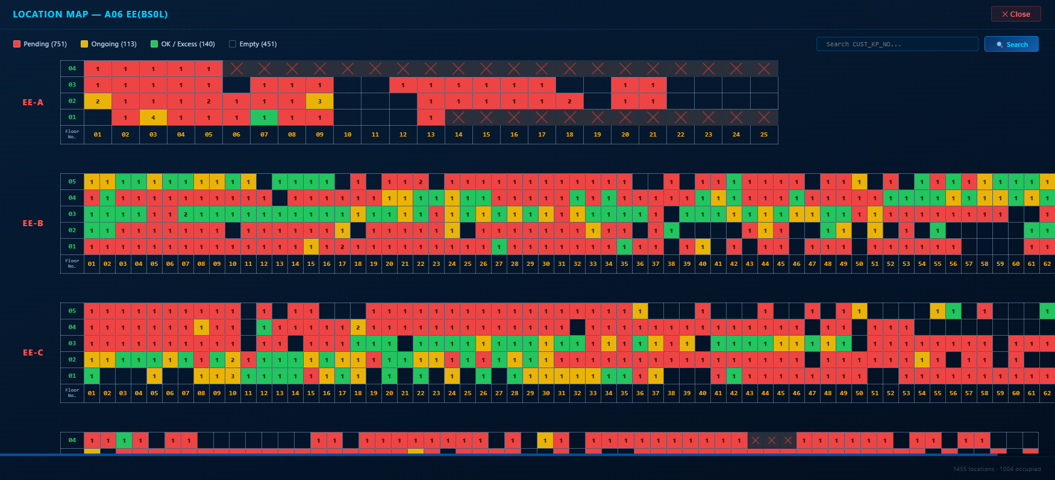
WAREHOUSE STOCK TRACKING
Live SAP-to-floor stock reconciliation across warehouse locations
Project member:
WH：Tung Chieh, Ben
IT develop：Chown
HOW TO USE THE DASHBOARD
LIVE DASHBOARD — IN PRODUCTION
2026/08/19
01
Monitor stock system-wide
Daily review materials tracked live across IAEB / IAEA plants and zones.
02
Spot gaps instantly
SAP stock vs Allparts physical/inventory count auto-flags shortage and excess.
03
Trace by location
Click any warehouse to open the live occupancy heatmap and search by material.
04
Resolve shortages fast
Drill into affected WOs per material and export the full report to Excel.
OUTCOME
Real-time SAP-to-floor reconciliation — shortages caught before they block production.
Location Heatmap on Click
BEFORE
AFTER
Manual cycle counts — shortages found after WO is blocked
Live SAP-to-floor sync — shortages flagged and traced instantly

Slide 3






FORKLIFT TASK DISPATCH
From manual coordination to a real-time web dispatch platform
Project member:
WH：Tung Chieh, Ben
IT Development：Chown
BEFORE
AFTER
✓
Create Picking & Return tasks — auto-fills location and quantity by WO/PN
Tasks assigned by phone or chat — easily missed or duplicated
!
Driver screen auto-sorts by priority and nearest location, one-tap confirm
Drivers don't know the next task — idle time, empty runs
✓
!
Safety risk from workers stationed under high racking — potential accidents from falling goods or forklift collisions.
✓
Instantly reassign a task to another truck when needed
!
Managers lack real-time visibility, hard to trace issues
✓
Only forklifts operate in the racking area — no workers stationed below, reducing accident risk
!
Full statistics — filter by time, employee, status; edit or delete as needed
✓
1
2
3
4
Dispatcher creates task
System prioritizes & selects location (FIFO)
Driver confirms in one tap
Time & status auto-logged

Slide 4

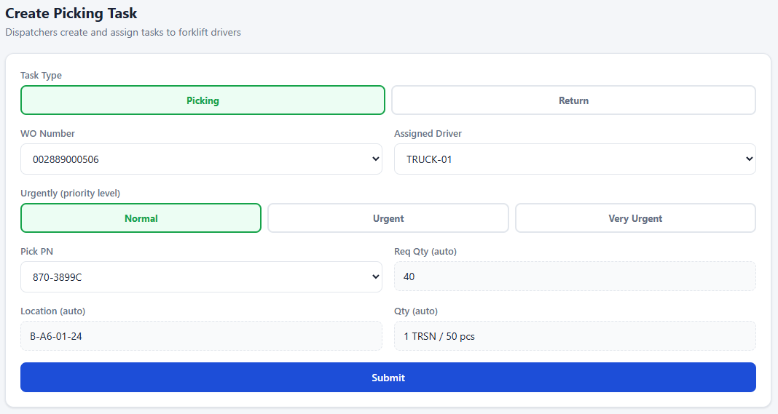
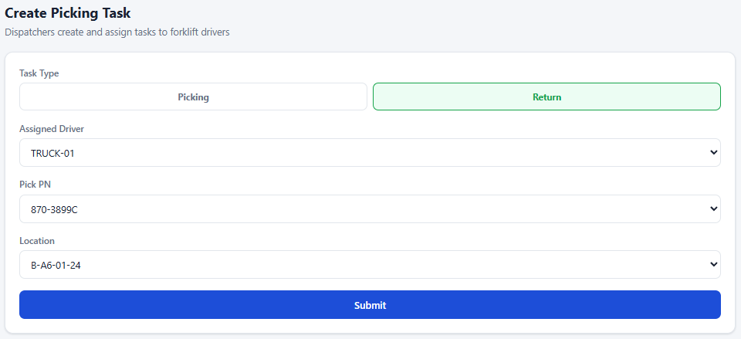

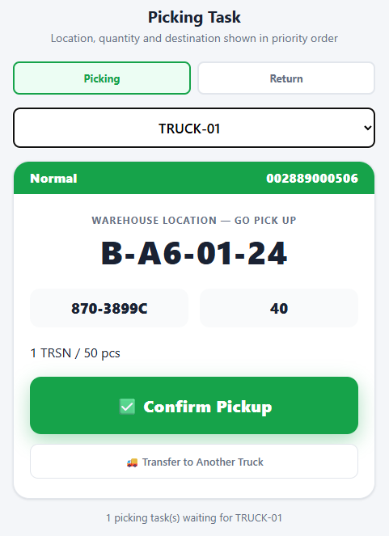
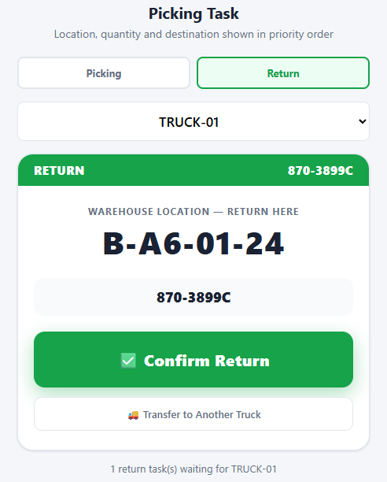
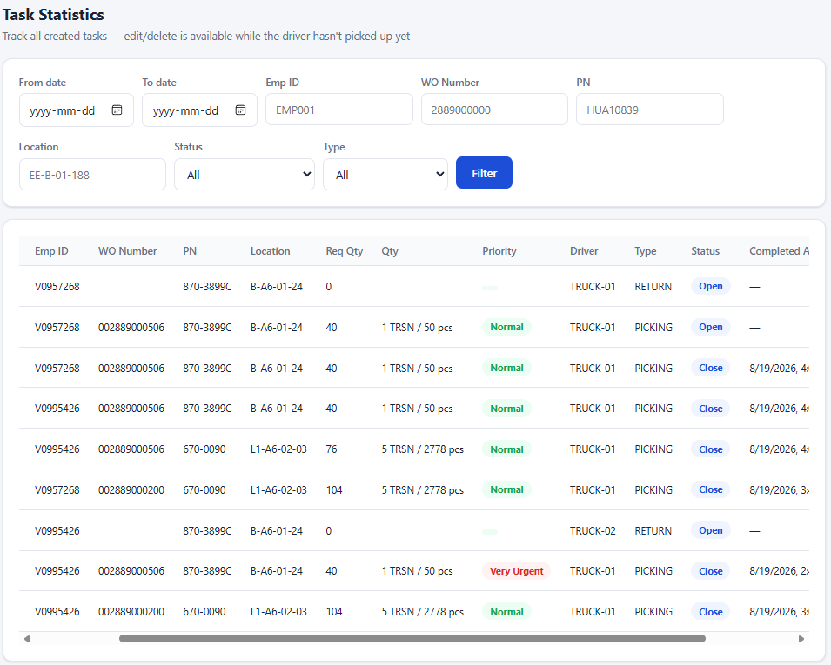

FORKLIFT TASK DISPATCH
Live interface in production
Project member:
WH：Tung Chieh, Ben
IT Development：Chown
CREATE TASK — PICKING & RETURN
DRIVER SCREEN(TABLET) — PICKING
DRIVER SCREEN (TABLET) — RETURN
STATISTICS & LOG

Slide 5
AUTO DESIGN LABEL
A
CNSBG-Billy Su
BEFORE — Manual Process
AFTER — Automated Process
!
Manually reading PMD documents — 30 minutes to 8 hours per model
✓
Auto-reads and interprets PMD documents — 100% hands-free
!
Redesigning in Codesoft 6 — requires separate license and training
✓
Automatically flags risks, unclear or conflicting definitions
!
MAC/RSN/coordinate entry errors — high defect rate in mass printing
✓
Auto-designs labels, allows direct review before and after export
!
Binary .lab files — no version control, no traceability
✓
Auto-generates ZPL code — the foundation for Phase 2 Codesoft 6 cost-down
OPERATING WORKFLOW
1
→
2
→
3
→
4
Read & Interpret Label Document
(System)
Auto Design
(System)
Review Results
(Under evaluation — CCD-based)
Export Label File
(System)
APPLICABLE TO ALL SITES:
LDM (Label Definition Model) is a schema-driven intermediate layer with no site-specific hardcoding — any site using PMD + Codesoft 6 can load it immediately, with no need to rebuild the engine.
2026 Auto Design Label — Internal. All Rights Reserved.
5/7

Slide 6
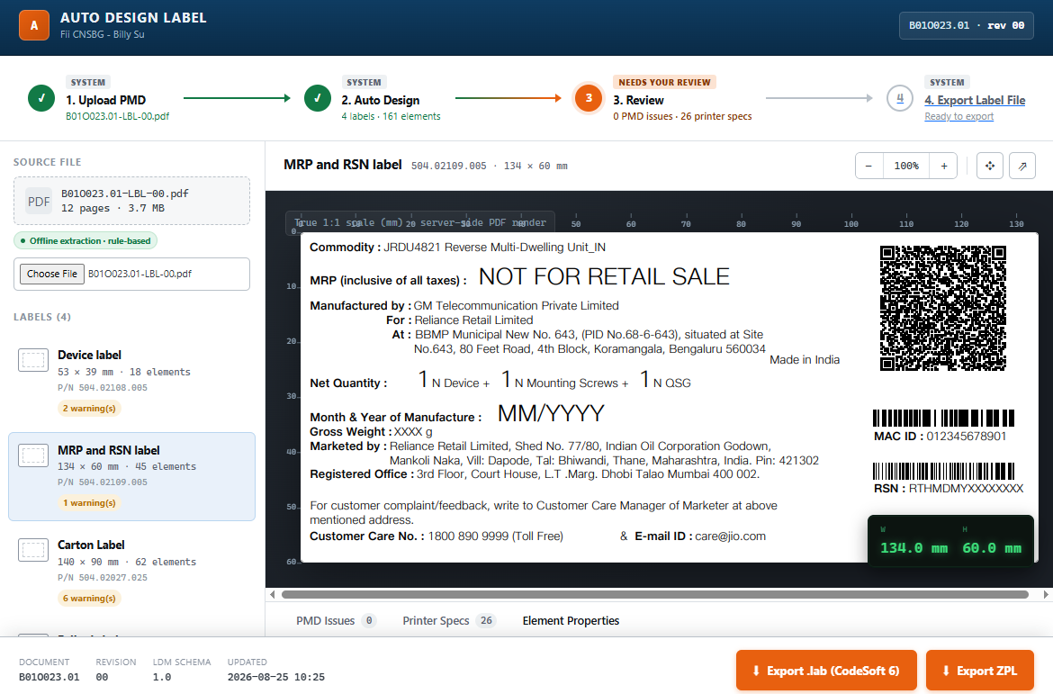
AUTO DESIGN LABEL
A
CNSBG-Billy Su
WHAT HAS BEEN DELIVERED
LIVE INTERFACE — DEMO IN PROGRESS
01
100% Automated Label Document Interpretation
Extracts all PMD content (dimensions, fonts, barcodes, QR codes, positions) into LDM (standardized JSON) — no manual reading required.
02
Automated Risk & Conflict Control
Flags masked values, unclear definitions, and conflicts between sections in the document — never infers a “correct” value on its own.
03
Automated Design + Direct Review
Generates label designs at true 1:1 scale (mm), enabling preview and review both before and after file export.
04
Automated ZPL Code Generation
Generates ZPL code directly from LDM — the technical foundation for Phase 2 to fully eliminate Codesoft 6 license costs.
OUTCOME
Document interpretation & design: 4 labels
On progress
Label Room no longer needs to read PMDs or build files by hand — the system handles the entire process; operators only confirm at the review step.
2026 Auto Design Label — Internal. All Rights Reserved.
6/7

Slide 7
SCALE TO ALL SITES
A
CNSBG-Billy Su
WHY IT SCALES ACROSS SITES
REQUIREMENTS FOR SITE ADOPTION
01
No Site-Specific Hardcoding
Requirement
Priority
LDM is a generic JSON schema — any site using the same PMD format and Codesoft 6 can load it directly, with no need to build a separate engine.
Label documents in PMD (PDF) format
Required
02
Shared Linter for All Standards
Currently using Codesoft 6 + Zebra printers
Required
Printability rules (X-dimension, QR density, boundary overflow) apply to every label type and every site — only the input data differs.
A representative document sample for initial LDM validation
Required
03
Hardware-Independent by Site
Site-specific font files (if different from JioType)
ZplEmitter and PrinterClient communicate over standard ZPL via port 9100 — compatible with any Zebra printer, not locked to any site-specific model.
Optional — Phase 2
04
Incremental Rollout, Zero Disruption
OUTCOME
Each site converts independently at its own pace — Label Room continues running CS6 in parallel until stability is confirmed.
The first site (pilot B01O023.01) was used only to validate the architecture — LDM itself is not tied to this site and is ready to load documents from any other site on demand.
2026 Auto Design Label — Internal. All Rights Reserved.
PHASE 1 — IN PROGRESS
7/7

